Slide 1
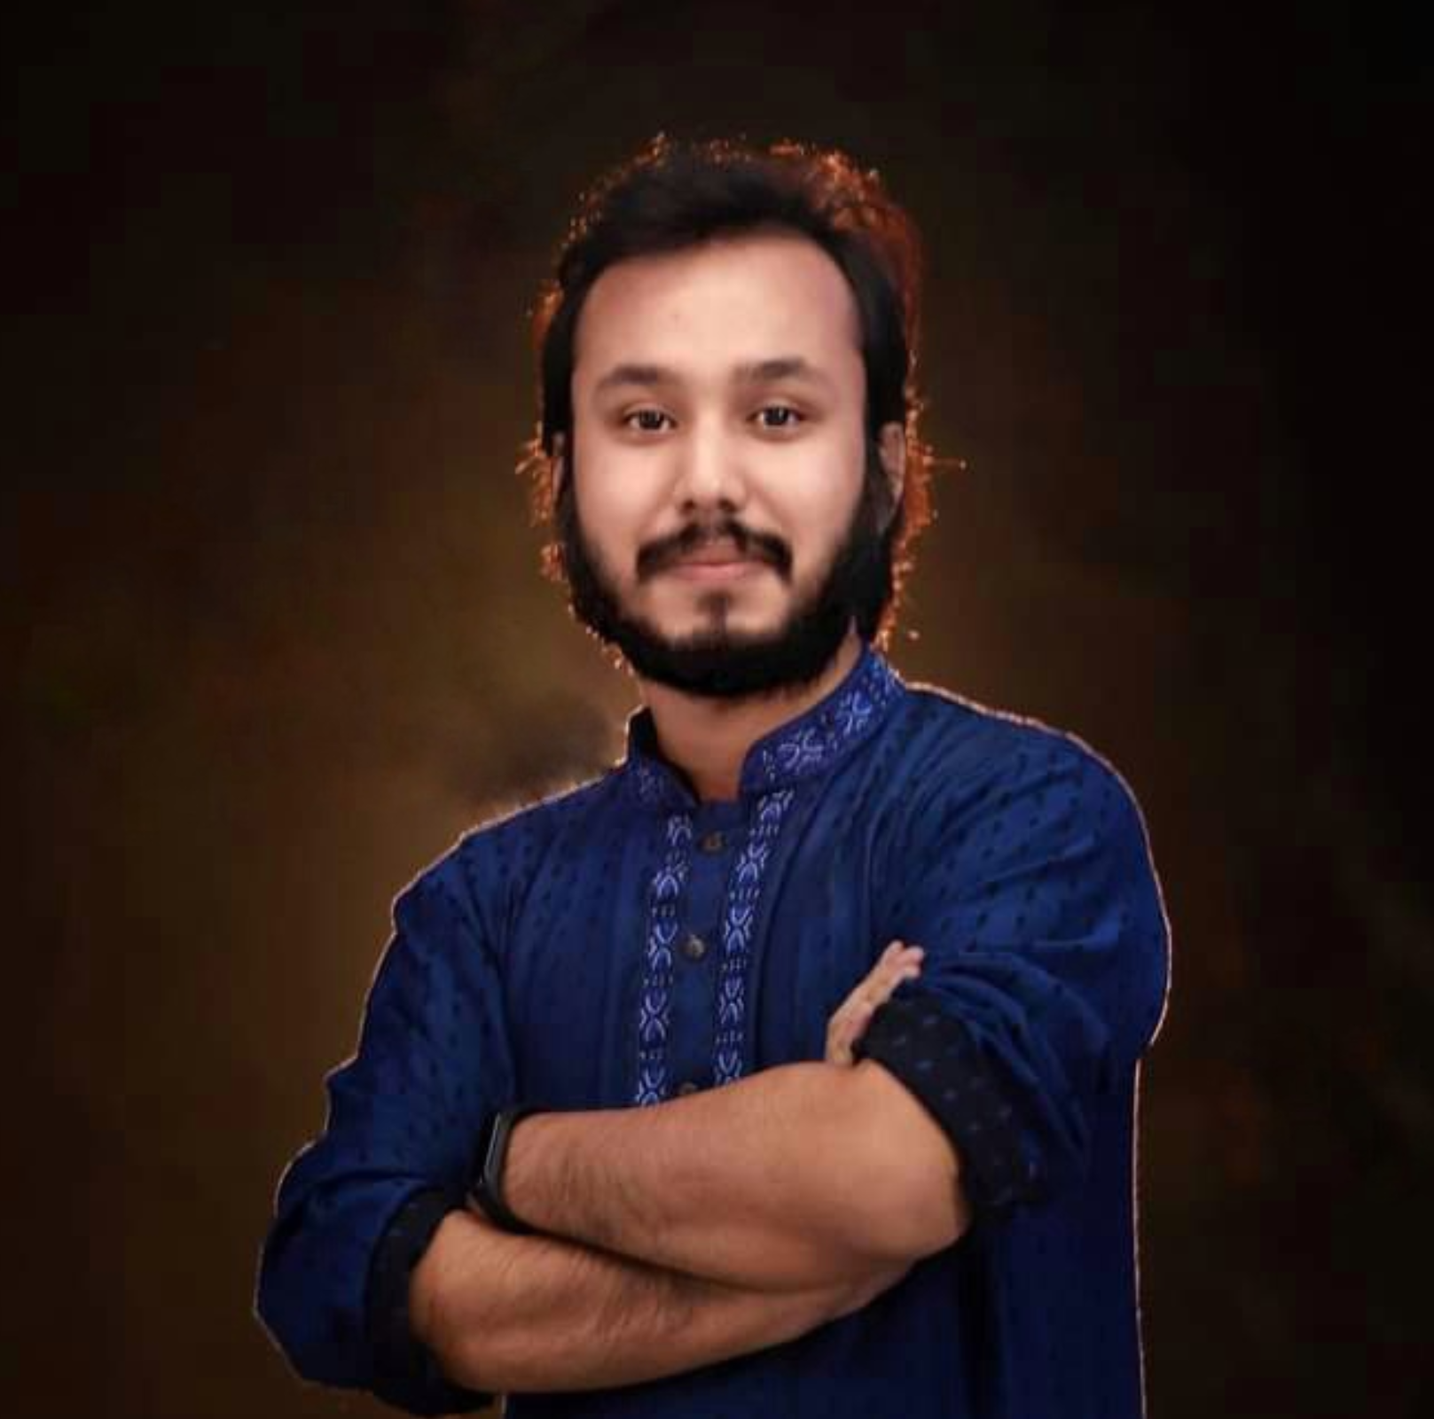
Kowshique Roy
Online Class
printf ( “Hello World” ) ;
Studying MSc in Computer Science (PMSCS) at
Jahangirnagar University
Whatsapp: 01765236683 Mail: kowshiqueroy@gmail.com Youtube: Dadar Class দাদার ক্লাস

Slide 2


Slide 3


Slide 4
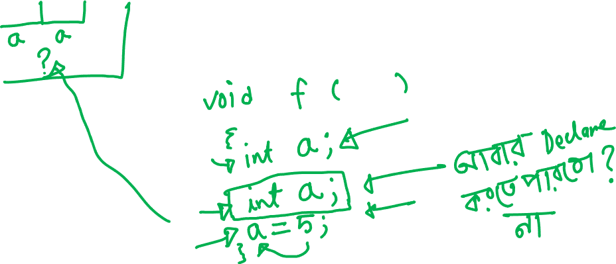

Slide 5


Slide 6
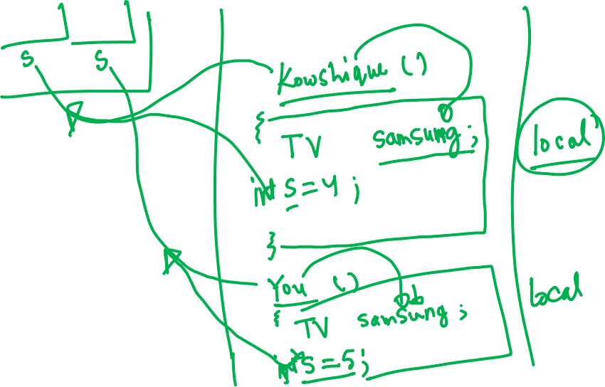

Slide 7


Slide 8
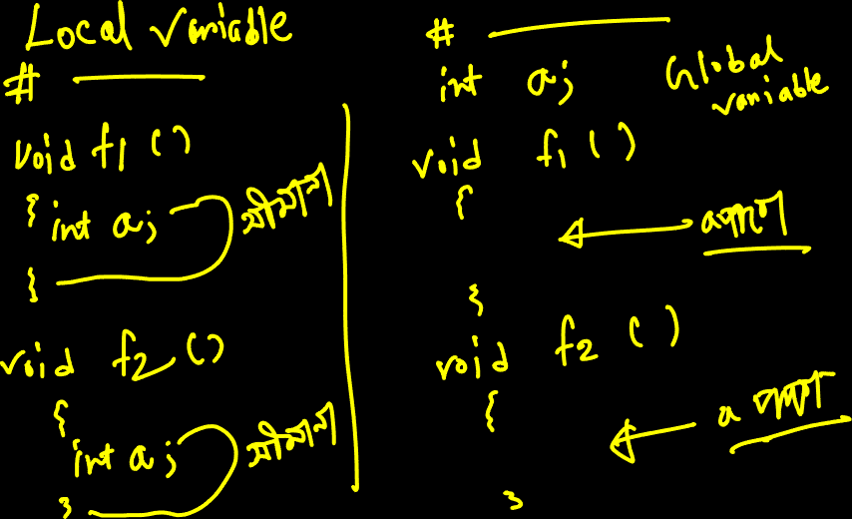

Slide 9
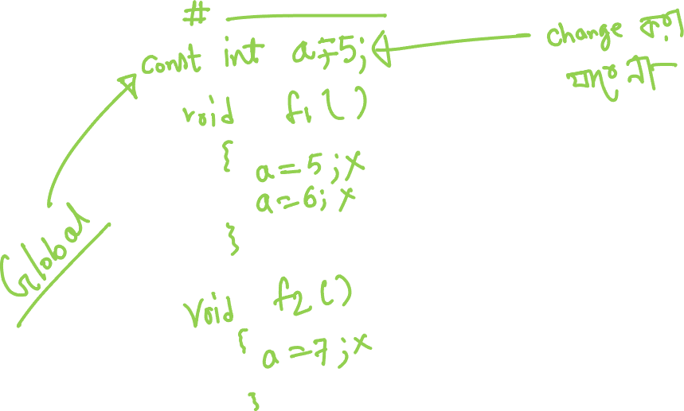

Slide 10
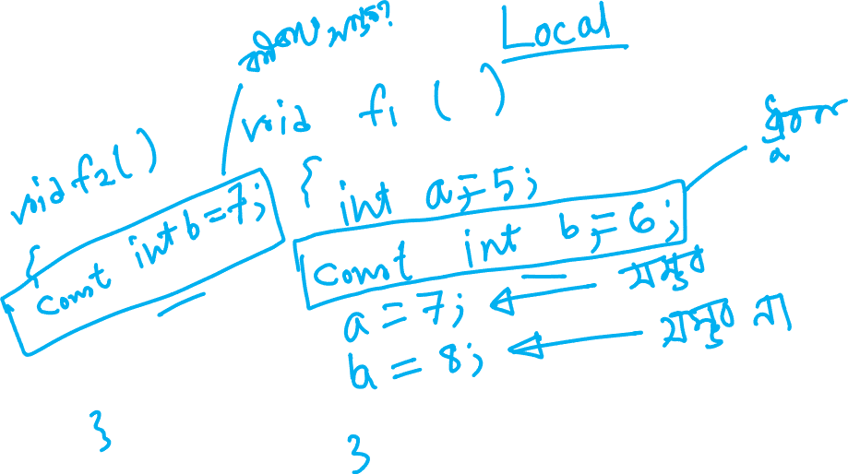

Slide 11
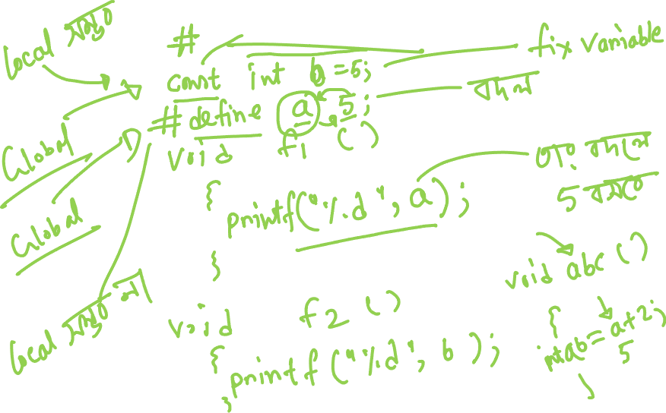

Slide 12


Slide 13
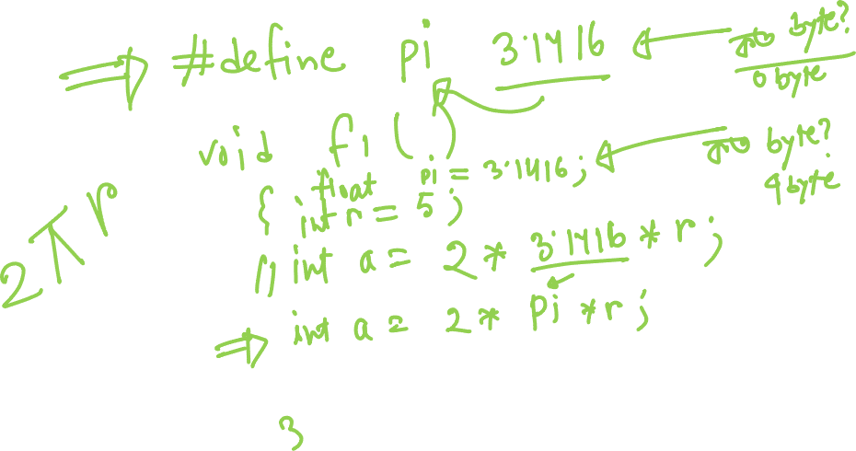

Slide 14
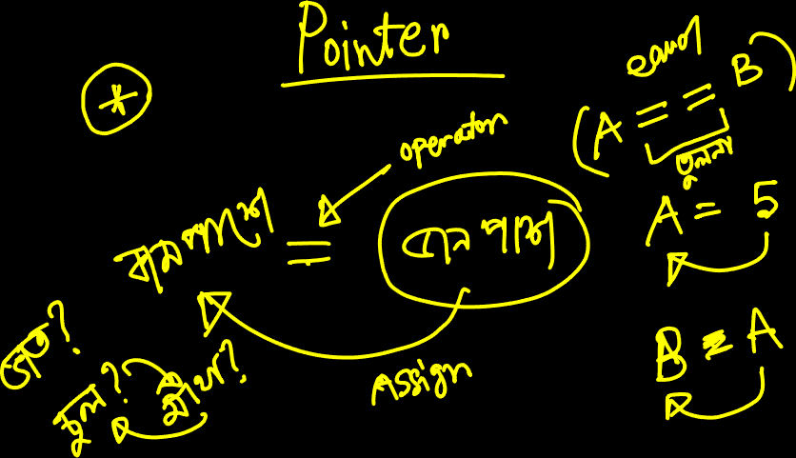

Slide 15
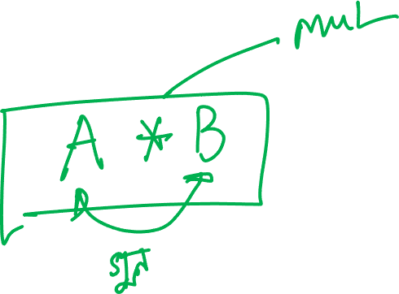

Slide 16
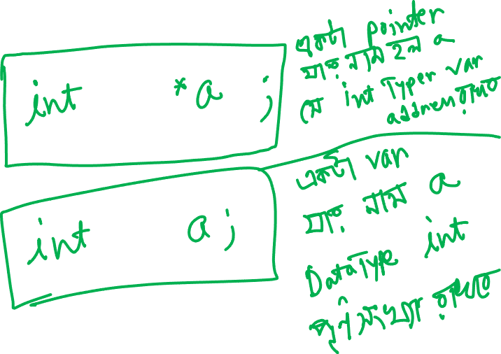

Slide 17
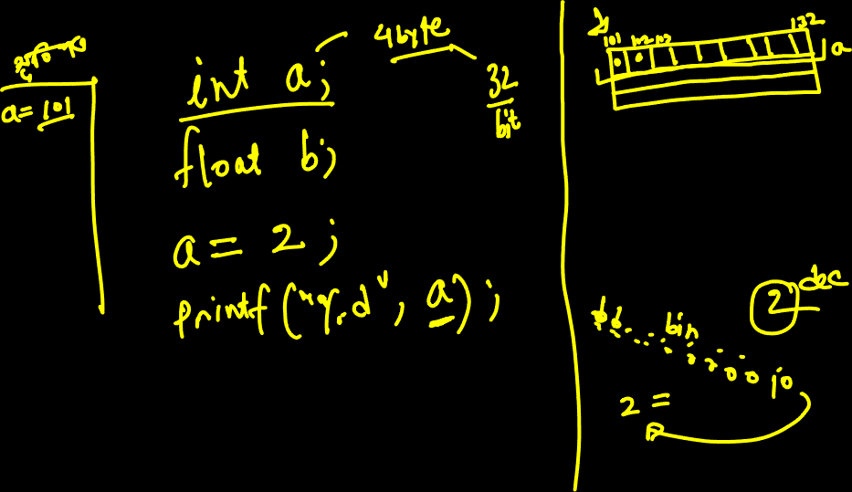

Slide 18
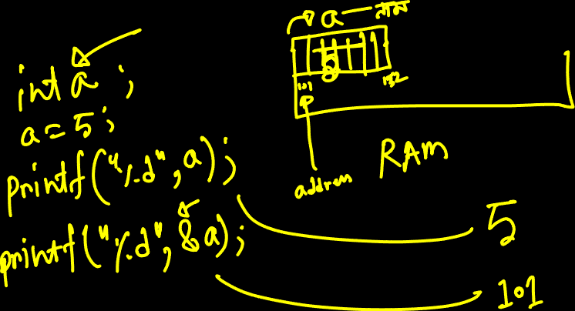

Slide 19
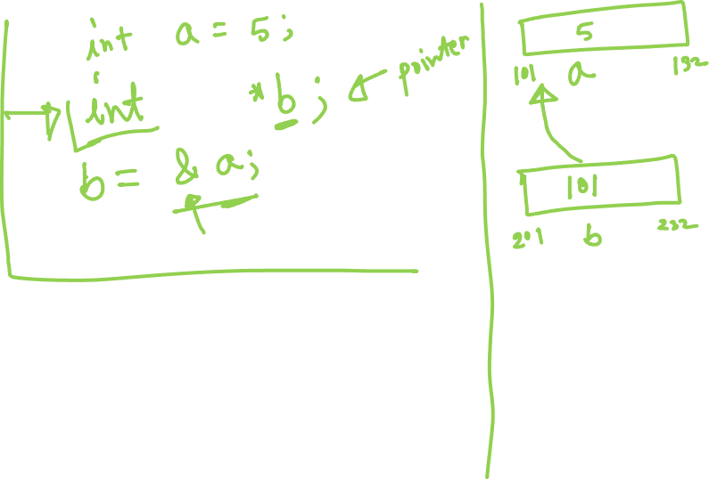

Slide 20


Slide 21


Slide 22


Slide 23


Slide 24
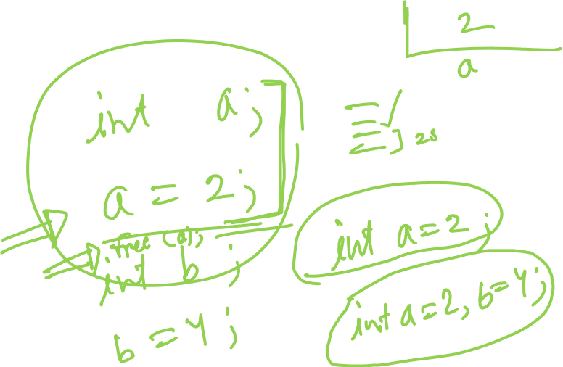

Slide 25


Slide 26


Slide 27
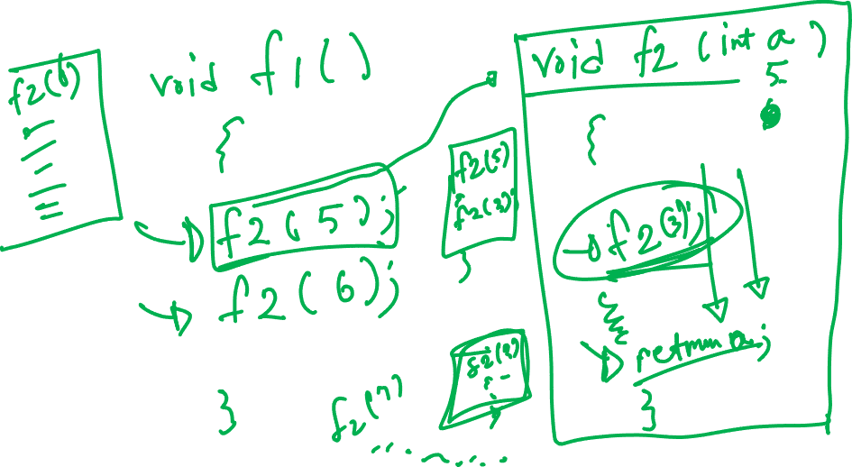

Slide 28
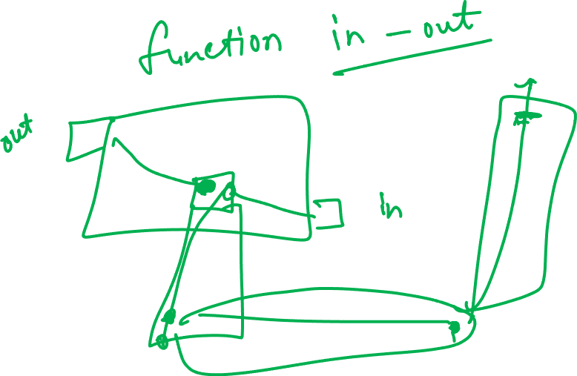

Slide 29


